Slide 1
Tambahan wawasan
Angelica kresnamurti, M.Farm., Apt.

Slide 2
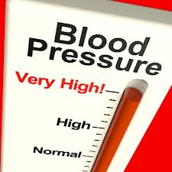
KLASIFIKASI HT
A.Hipertensi esensial (HT primer)= HT
Idiopatik, yg blm jelas penyebabnya.
Dipengaruhi usia, jenis kelamin, merokok,
kholesterol, Berat badan
B.Hipertensi sekunder.
Dipengaruhi oleh obat, penyakit ginjal, penyakit
endokrin (DM, tiroid, Cushing syndrome)

Slide 3
(((DiPiro, 2011)

Slide 4
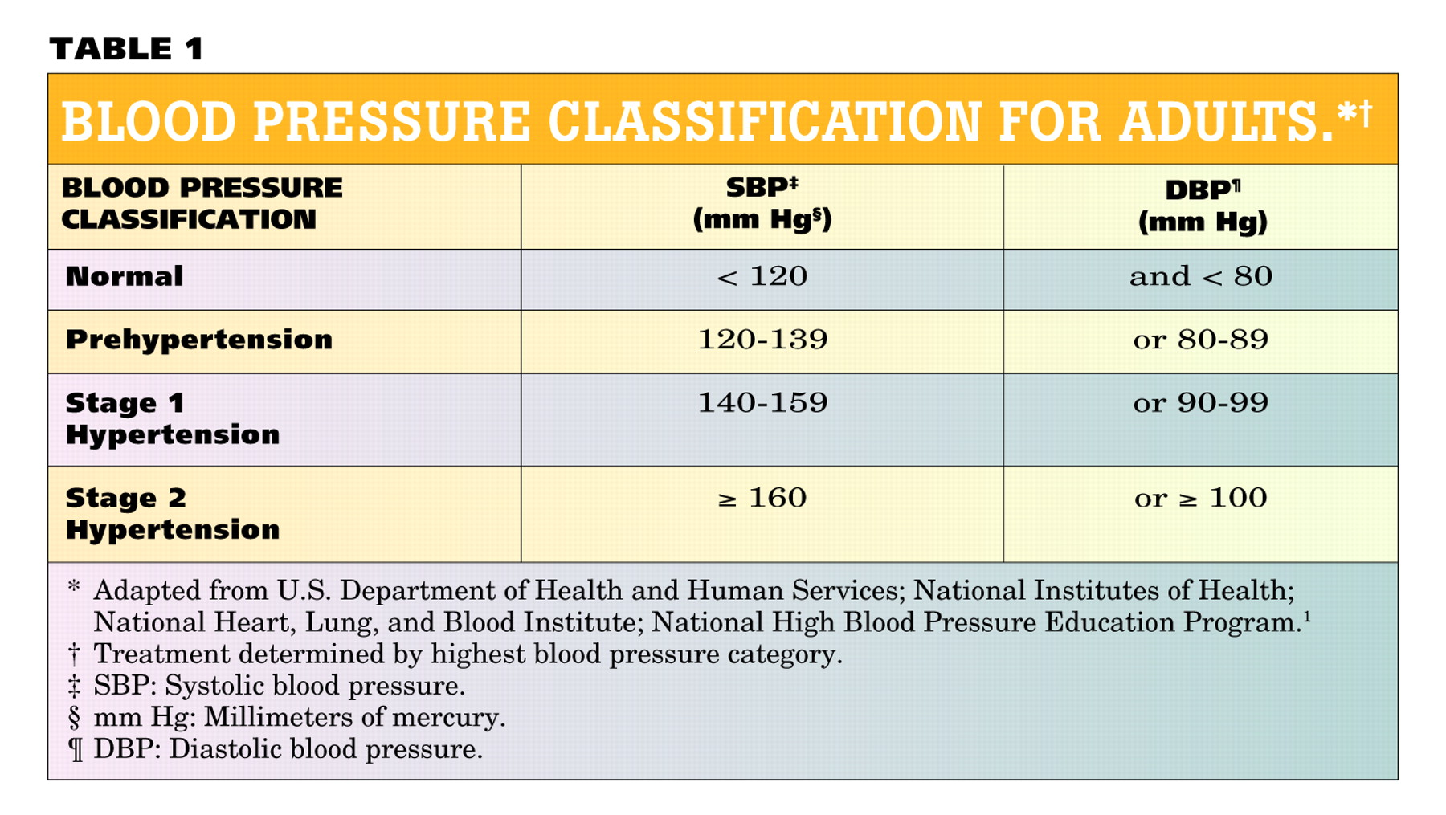
KLASIFIKASI TEK DARAH
JNC-7
Normal | <120 | and | <80
Prehypertension | 120–139 | or | 80–89
Stage 1 Hypertension | 140–159 | or | 90–99
Stage 2 Hypertension | >160 | or | >100
(JAMA, 2003= JNC-7)

Slide 5
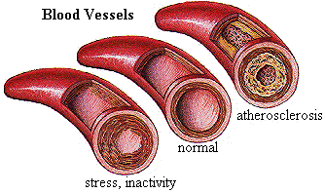
Treatment Options for Hypertension
Prevention is the best treatment strategy
The goal of treatment:
  Lower blood pressure to prevent associated complications
  Typically <140/90 mmHg
  130/80 for renal failure
http://www.physicaltherapy.ca/cardio/Hypertension1.html

Slide 6
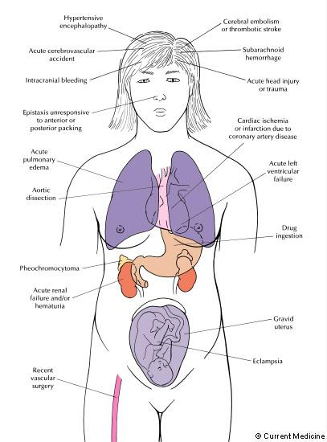
Emergencies & Urgencies
HYPERTENSIVE EMERGENCIES
  Require immediate blood pressure reduction (not necessarily to normal range) to prevent or limit target organ damage.
HYPERTENSIVE URGENCIES
  Require reduction of blood pressure within a few hours
Tekanan darah 180-190/100-110 tanpa komorbid penyakit stroke

Slide 7
(FARKOMNIK, 2008)

Slide 8
Terapi Kombinasi
Rasional kombinasi obat antihipertensi:
Ada 6 alasan mengapa pengobatan kombinasi pada hipertensi dianjurkan:
1. Mempunyai efek aditif
2. Mempunyai efek sinergisme
3. Mempunyai sifat saling mengisi
4. Penurunan efek samping masing-masing obat
5. Mempunyai cara kerja yang saling mengisi
pada organ target tertentu
6. Adanya “fixed dose combination” akan
meningkatkan kepatuhan pasien (adherence)

Slide 9
Fixed-dose combination yang paling efektif adalah sebagai berikut:
1. Penghambat enzim konversi angiotensin (ACEI)
dengan diuretik
2. Penyekat reseptor angiotensin II (ARB) dengan
diuretik
3. Penyekat beta dengan diuretik
4. Diuretik dengan agen penahan kalium
5. Penghambat enzim konversi angiotensin (ACEI)
dengan antagonis kalsium
6. Agonis α-2 dengan diuretik
7. Penyekat α-1 dengan diuretic

Slide 10
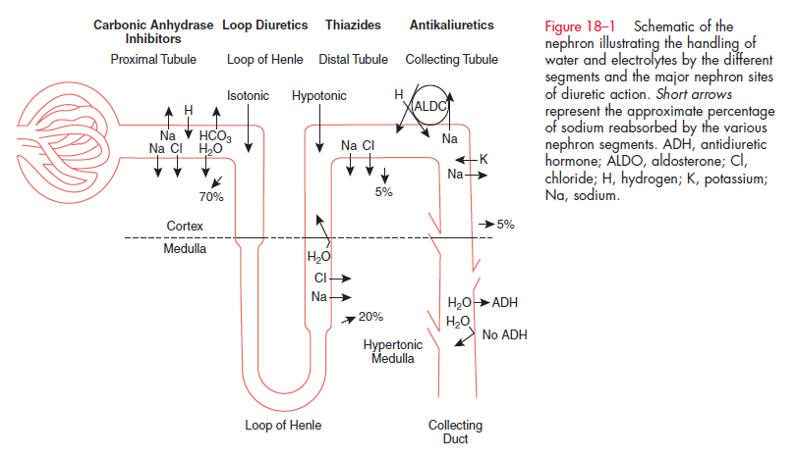
Diuretika
(Braunwald, 2013)

Slide 11
ALGORITMA Tx HT
Lifestyle Modifications
Not at Goal Blood Pressure (<140/90 mmHg)
(<130/80 mmHg for those with diabetes or chronic kidney disease)
Initial Drug Choices
Without Compelling
Indications
With Compelling
Indications
Stage 1 Hypertension
(SBP 140–159 or DBP 90–99 mmHg)
Thiazide-type diuretics for most.
May consider ACEI, ARB, BB, CCB,
or combination.
Stage 2 Hypertension
(SBP >160 or DBP >100 mmHg)
2-drug combination for most (usually thiazide-type diuretic and
ACEI, or ARB, or BB, or CCB)
Drug(s) for the compelling indications
Other antihypertensive drugs (diuretics, ACEI, ARB, BB, CCB)
as needed.
Not at Goal
Blood Pressure
(JNC-7, 2003)
Optimize dosages or add additional drugs
until goal blood pressure is achieved.
Consider consultation with hypertension specialist.

Slide 12
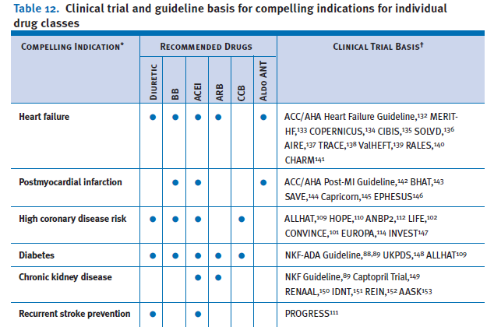
(Pharmacy Therapy, 2003)

Slide 13
ABCD Compare & Contrast (Braunwald, 2013)
Parameter | Diuretic | ACEi, ARB | βblocker | Ca⁺ Blocker
Ischemia | No effect | Improves | Improves | Negative
LVH, LVF | Improves | Improves | Improves* | Negative
CV Mortality | Improves | Improves | Improves | Increases
Heart rate | No effect | No effect | Bradycardia | Tachycardia
Use in DM | Negative | Excellent | Negative | Negative
Lipid effects | Negative | Excellent | Negative | Neutral
Fluid & Na | Enhances | No effect | Vasoconstr. | Vasodilatory
K ex / bronchi | Enhances | No effect | Bronchospa | No effect
UA / Conduct. | ↑ Uric acid | No effect | ↓conduction | No effect

Slide 14
(Drug Topics, 2003)

Slide 15
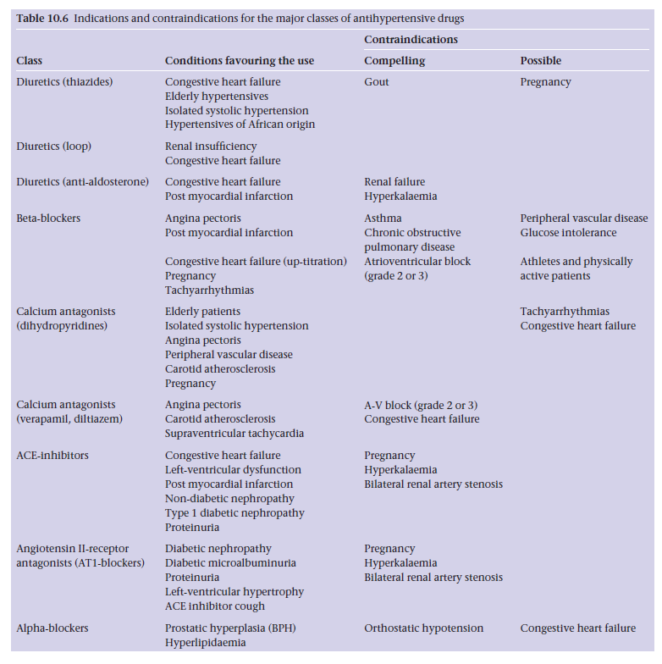
Braunwald, 2013

Slide 16
Monitoring Antihypertensives
Class | Parameters
Diuretics | blood pressure BUN/serum creatinine serum electrolytes (K+, Mg2+, Na+) uric acid (for thiazides)
β-Blockers | blood pressure heart rate
Aldosterone antagonists ACE inhibitors Angiotensin II receptor blockers Direct Renin inhibitors | blood pressure BUN/serum creatinine serum potassium
Calcium channel blockers | blood pressure heart rate
DiPiro JT, Talbert RL, Yee GC, Matzke GR, Wells BG, Posey LM: Pharmacotherapy:A Pathophysiologic Approach, 7th Edition: http://www.accesspharmacy.com/

